Slide 1


Slide 2

WHO WE ARE?
We are started in 2013, as the first E-Sports Organization
among all the Universities in Sri Lanka.
We are still the leading esports organization among all
the universities.

Slide 3
STRUCTURE OF GC
Lecturers In Charge : Who guides the GC
Executive Board Members : Who leads the GC.
Backstage Crew : Who makes the GC.
Community Members : Next generation of GC.

Slide 4
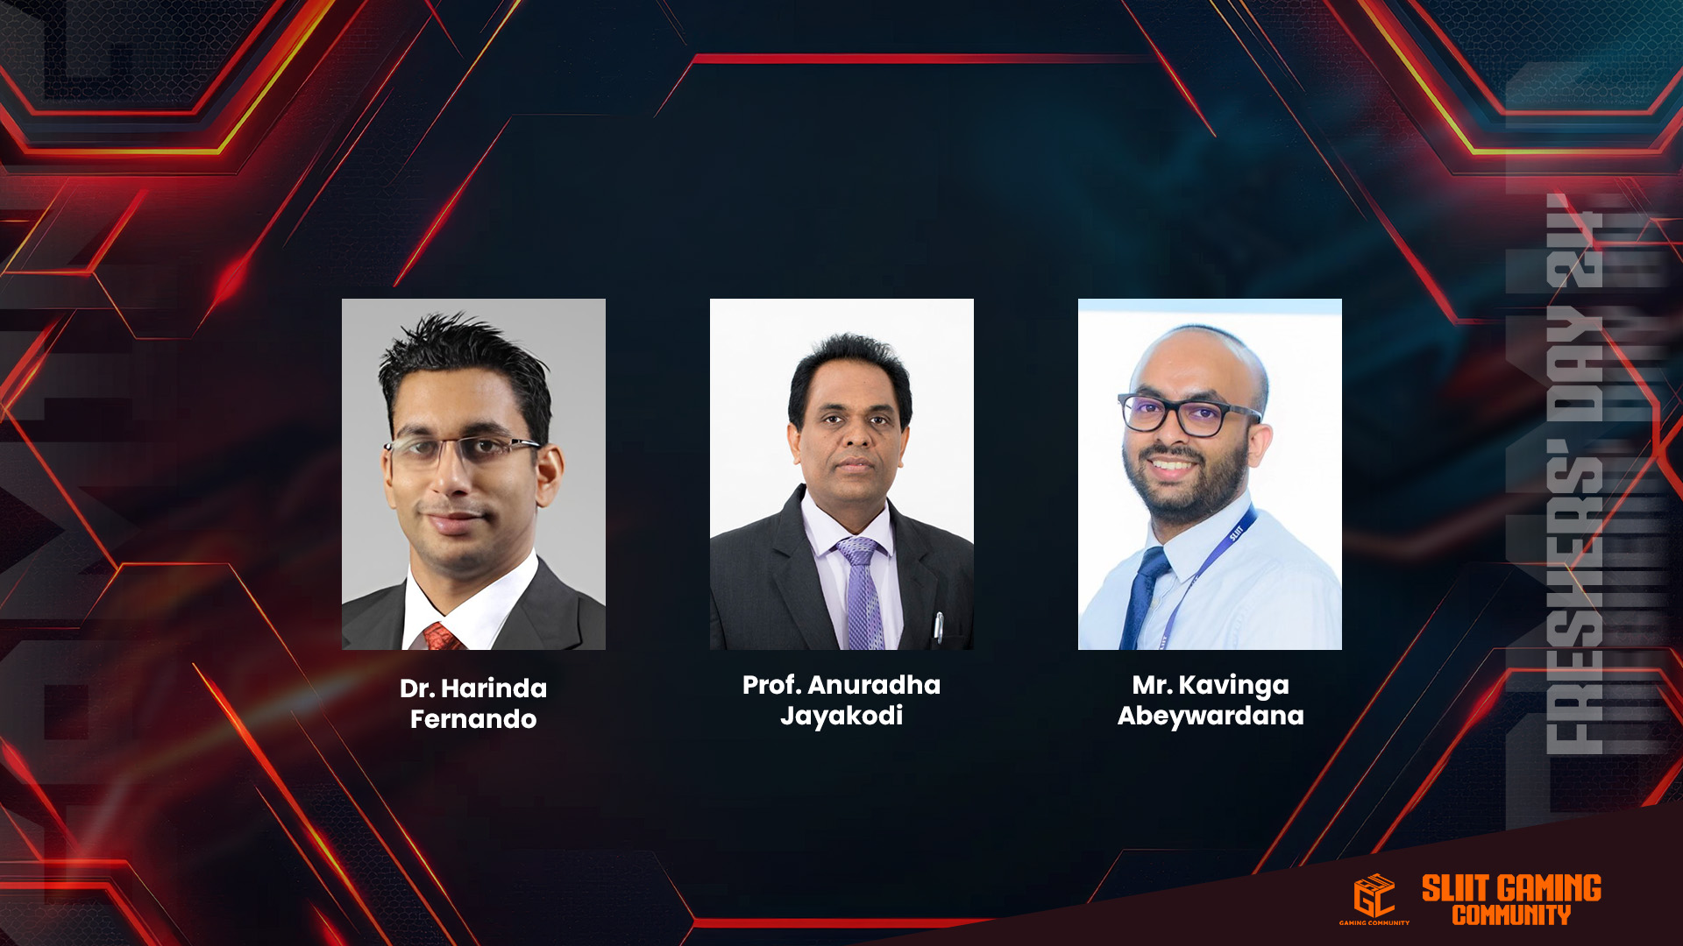
LECTURERS IN CHARGE

Slide 5
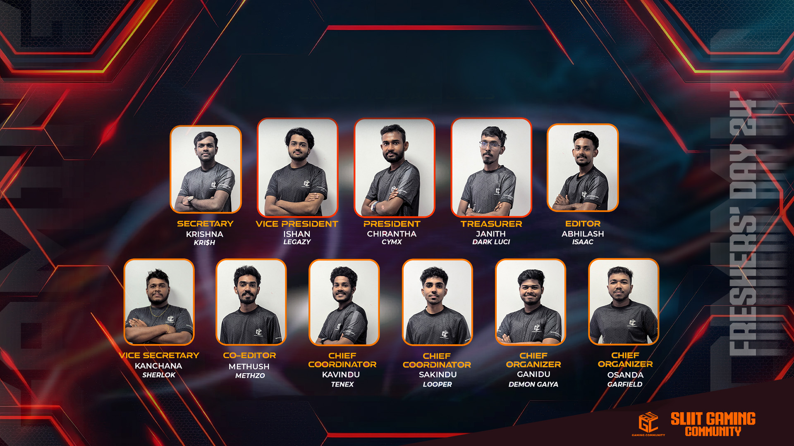
EXECUTIVE BOARD 24/25

Slide 6
COMMITTEE MEMBERS
Co- Editor - W.M.A. THAMEL
Vice Secretary - K.S.R Jayasekara
Deputy Chief Organizer - U.D Ganidu Sathishka
Deputy Chief Coordinator - S.D. Ranasinghe
Media Department Head - D.N.N.W Kaluarachchi
GFX Department Head - M.M.P. De Costa
VFX Department Head - R.A.V.R Perera
Content Department Head - W.L.A.T Wijetunga
Streaming Department Head - P.K.S FERNANDO

Slide 7
SUB-COMMITTEE MEMBERS
Deputy Media Department Head - I.K.G.S.P.B. Ihalakorala
Deputy GFX Department Head - Anuradha Lakshman Bandara
Deputy VFX Department Head - N.K. Tharuka Thidas Pathmasiri
Deputy Content Department Head - W.A.P.N Athukorala
Deputy Streaming Department Head - Y.U.A Rathnayaka

Slide 8
DEPARTMENTS OF GC
Media Department
Graphics Department
VFX Department
Content Department
Streaming Department

Slide 9
WHAT WE DO IN GC?
Gaming related workshops
Tournaments
Streaming
Collaborate with other Clubs
Encourage gamers to participate on top leagues like IUEC, Nebula, UCL

Slide 10
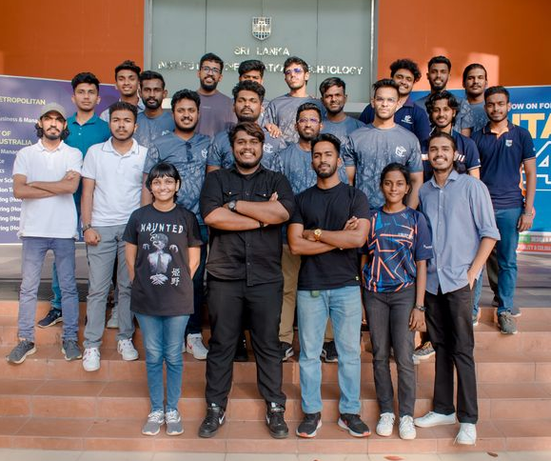
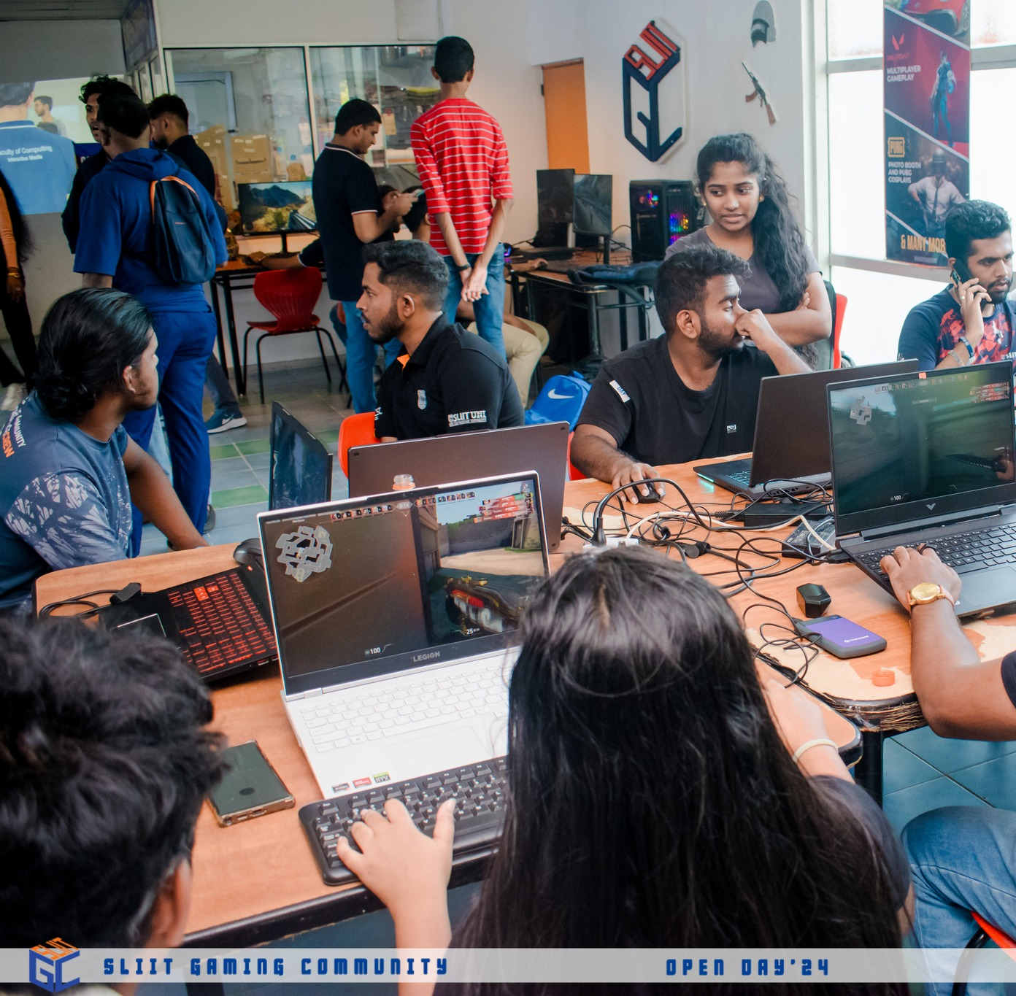
OPEN DAY 2024

Slide 11

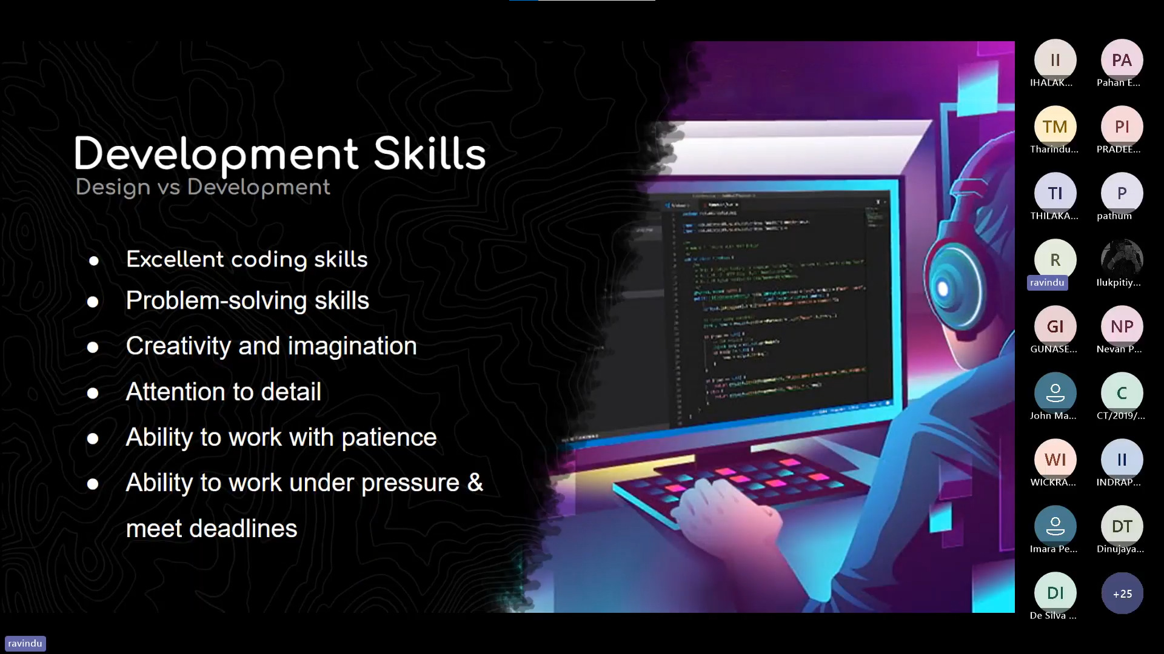
GAME CODE 1.0

Slide 12
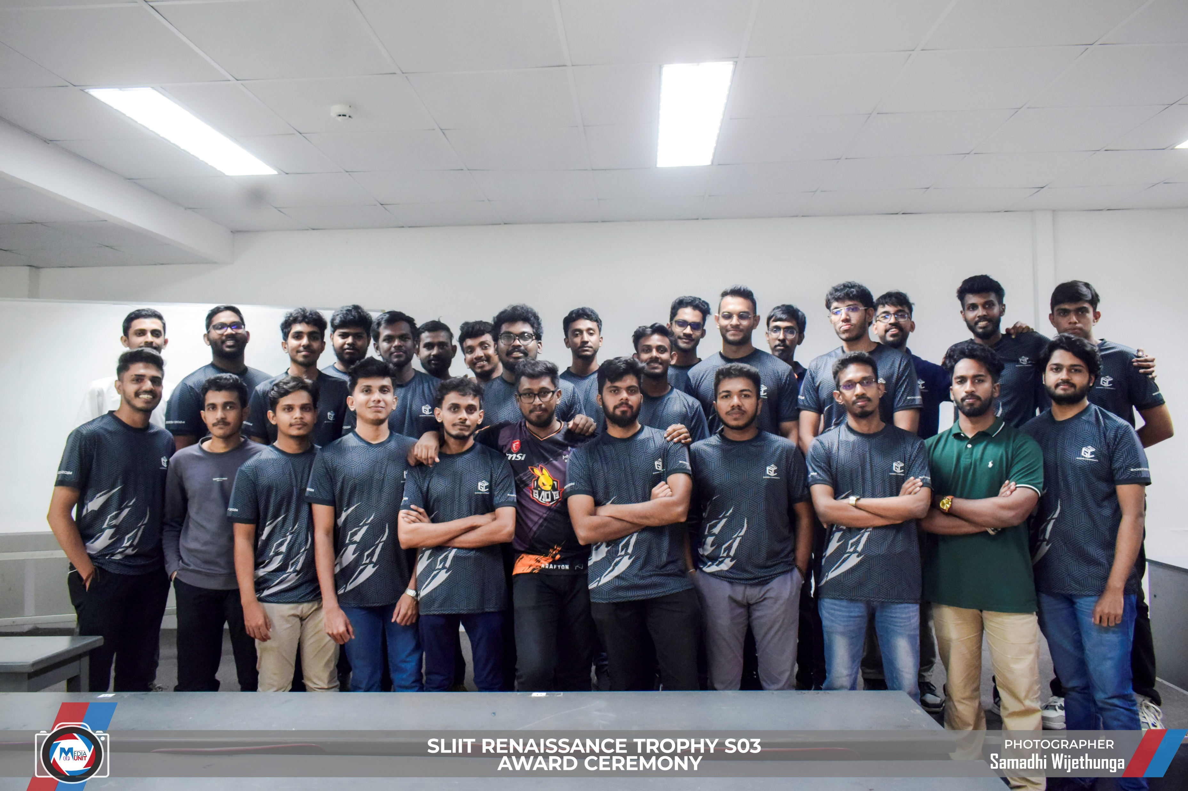

RENAISSANCE TROPHY SEASON 03

Slide 13


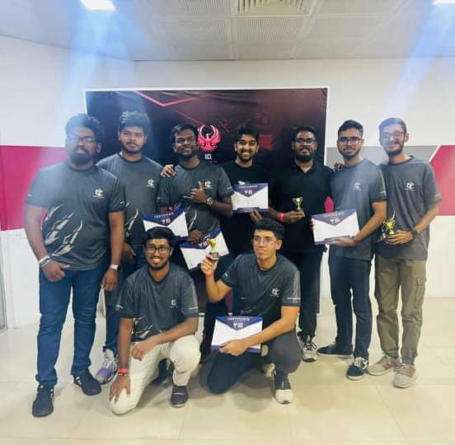
ACHIEVEMENTS

Slide 14
OUR FUTURE PLANS
Live Streaming –
Live game streaming is all the rage these days, and our gaming community is no exception. We're proud to have talented streamers among our own members.

Slide 15
OUR FUTURE PLANS
Gaming Tournaments –
Online Tournaments (RENAISSANCE S4)
Mini-LAN Tournaments (GameFest)

Slide 16
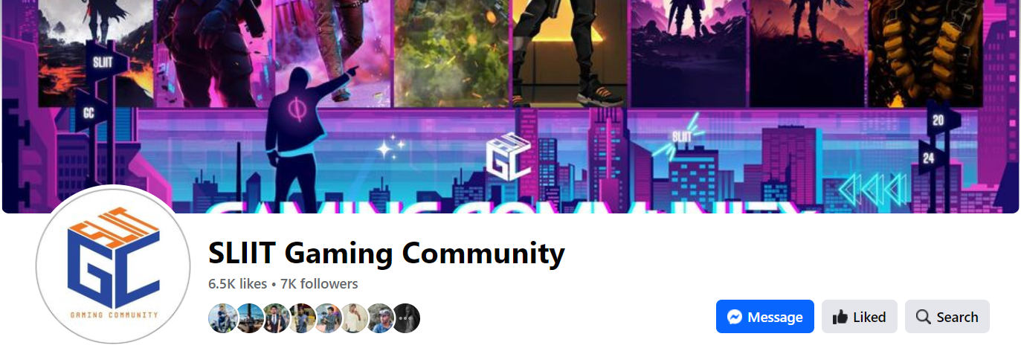
OUR FACEBOOK PAGE
Our Facebook page, "SLIIT Gaming Community," with about 7K followers, is your one-stop hub for community updates, promotions, and shared experiences in the gaming world. Join us for all things gaming!

Slide 17
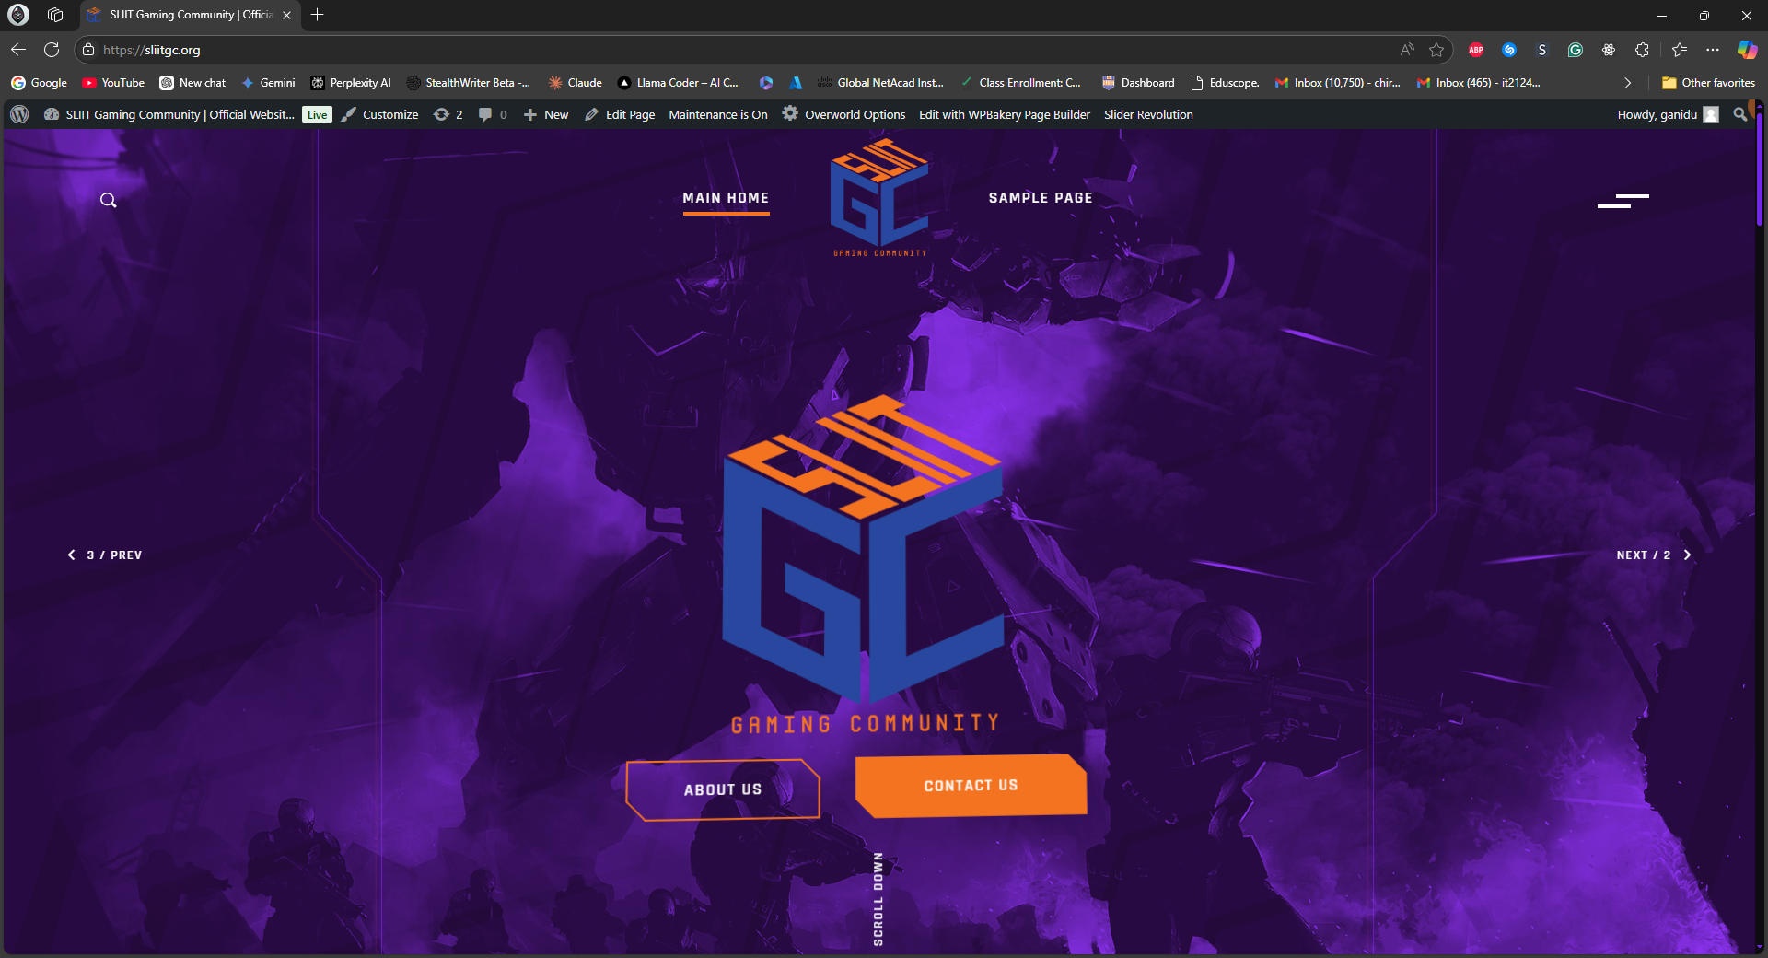
OUR WEBSITE
*Still Under Constructions

Slide 18


FOLLOW US ON
SLIIT GAMING COMMUNITY

Slide 19
THANK YOU !

